Slide 1
Min-Max Optimization in GANs
Team Project 8

Slide 2
Motivation
Why Min-Max Optimization Matters in Deep Learning
Generative Adversarial Networks (GANs) are revolutionizing data generation
Capable of creating highly realistic images, videos, and other synthetic data
Critical in fields like computer vision, medical imaging, and creative design
Fundamental Challenge: Optimization in Adversarial Settings
Training GANs requires balancing two competing neural networks
Traditional optimization methods often fail due to:
Oscillations in training
Lack of convergence
High-dimensional complexity
Key Insight: Improving optimization can unlock more stable and powerful generative models

Slide 3
The Min-Max Optimization Challenge in GANs
Mathematical Formulation
GAN Training as a Min-Max Problem: min(G) max(D) E[log D(x)] + E[log(1 - D(G(z)))]
Where:
G = Generator (creates synthetic data)
D = Discriminator (distinguishes real vs. synthetic data)
x = Real data distribution
z = Latent space/random noise
Optimization Challenges
Gradient Ascent-Descent Method Limitations
Slow convergence
High instability
Dimension-dependent performance
Current Optimization Approaches
Standard methods like Adam and RMSProp
Inherent difficulties in maintaining training stability
Prone to mode collapse and divergence

Slide 4
How the Algorithm Works
Start with Initial Point (x0, y0)
The game begins from a given starting position.
Max-Player (Y) Update
For fixed x, Y climbs upwards using gradient ascent.
Stops when no further increase is possible (reaches a local peak).
Min-Player (X) Proposes a Change
Picks a small random move (Δ) from the proposal distribution to x.
Checks if the new value of f(x+Δ, y) is smaller after Y updates.
Decision: Accept or Reject the Move
If it helps (lowers loss function f), accept the move.
If it doesn’t, reject OR accept with small probability to allow exploration.
Repeat This Loop
Keep proposing, updating, and checking.
Gradually become pickier in accepting moves (simulated annealing style).
Stop When Stuck
If many moves fail to improve the value, we stop.
That means we have likely found a local equilibrium: X can’t reduce further, and Y is at a local peak.

Slide 5
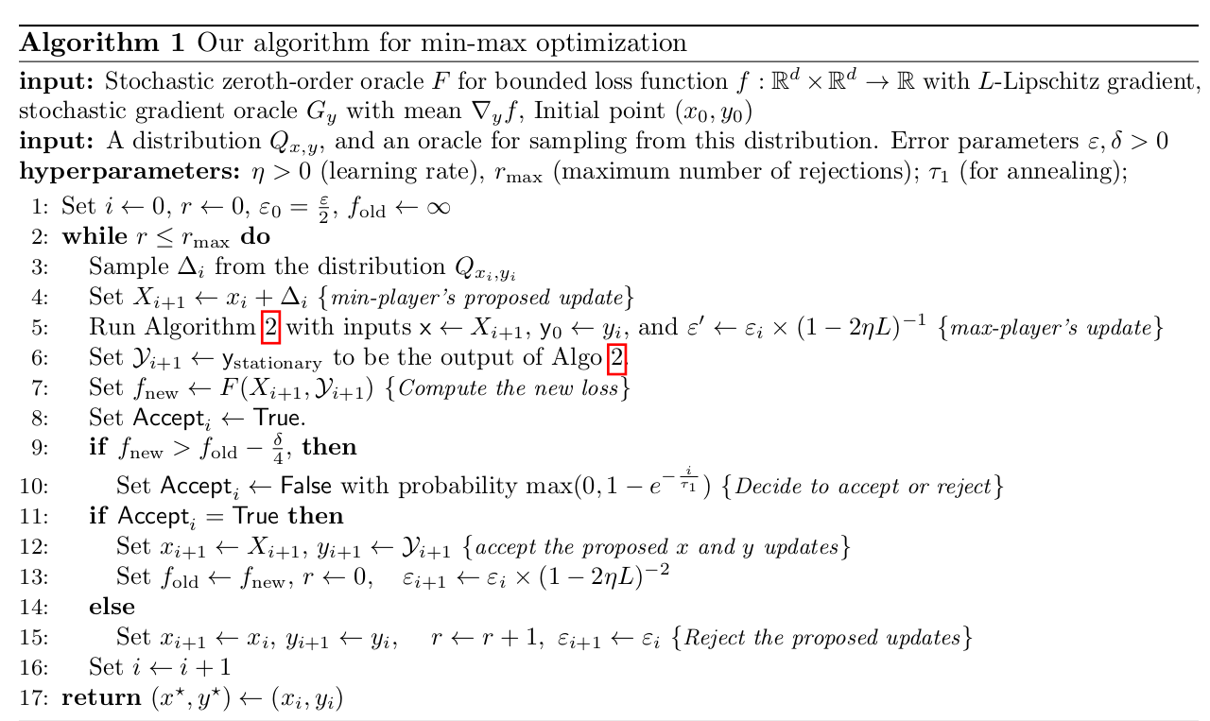

Slide 6
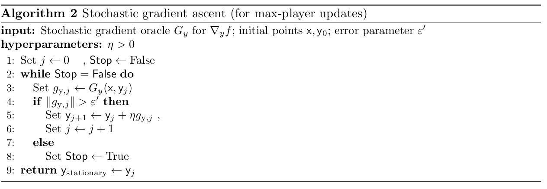

Slide 7
Innovative Aspects
The key innovation lies in its ability to find equilibrium points efficiently without being affected by the dimensionality of the problem.
The proposed method restricts the max-player (discriminator in GANs) to update its parameters in a greedy manner until reaching a first-order stationary point.
The min-player (generator) updates its parameters using a proposal distribution, ensuring stable convergence.

Slide 8
Phase-2

Slide 9
Progress
GDA (Generative Discriminant Analysis):
Ran the GDA code from the Coursera GAN course and tested it on the MNIST dataset.
Results: The model showed some initial success but did not do well for large number steps .
The Algorithm: Convergent and Dimension-Independent Min-Max Optimization
Implemented this algorithm and tested it on the same MNIST dataset.
Results: Similar to GDA, the results are not fully reliable, as the algorithm was also trained for only a very few iterations ( only 2000 ) .

Slide 10
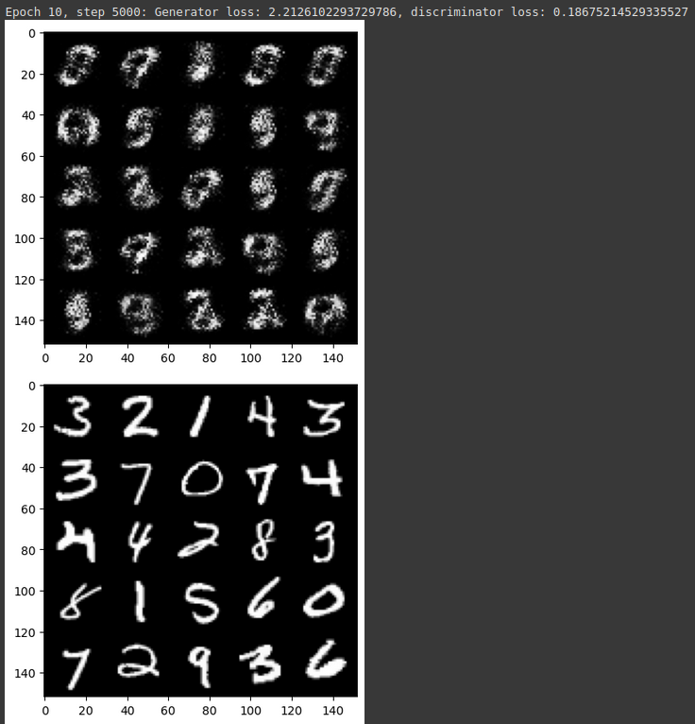
GDA Results

Slide 11
Analysis of GDA
(Epoch 10, Step 5000)
Generator loss: 2.2126
Discriminator loss: 0.1868
High Generator Loss: Indicates the generator is struggling—its outputs are easily classified as fake.
Low Discriminator Loss: The discriminator is confident and effectively distinguishing fake from real data.

Slide 12
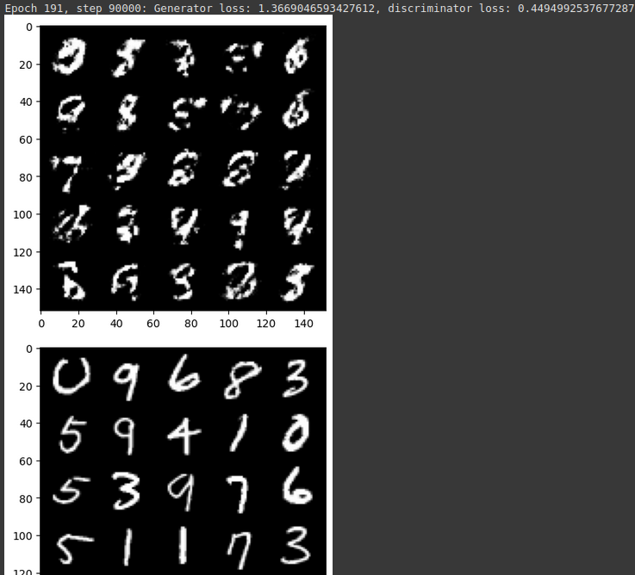
GDA result

Slide 13
Analysis of GDA
Epoch 191, Step 90000)
Generator loss: 1.3669
Discriminator loss: 0.4495
Generator Loss Decreased: Better at fooling the discriminator, but still not optimal.
Discriminator Loss Increased: Suggests it’s starting to get tricked, i.e., generator is improving.

Slide 14
Future work
Implement the our algorithm within standard GAN architectures such as DCGAN and StyleGAN.
Compare the convergence speed and training stability with traditional optimizers like Adam and RMSProp.
Assess the quality improvements in generated samples using metrics such as FID and Inception Score

Slide 15
Post Phase 2
Task :
Final: train keswani’s algorithm fully, and compare with GDA. Make tables and show generated images.

Slide 16
A small problem…
The algorithm was not able to train for more then 2000 iteration because google colab keep crashing due to excess usage of RAM.
So we are comparing the algorithm with GDA for every 400 iterations of training.

Slide 17
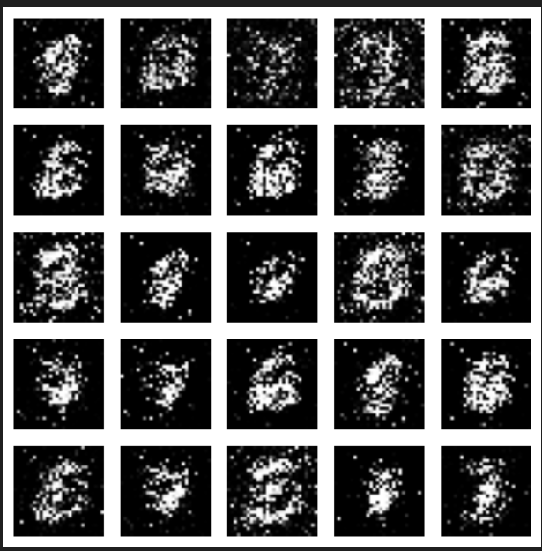
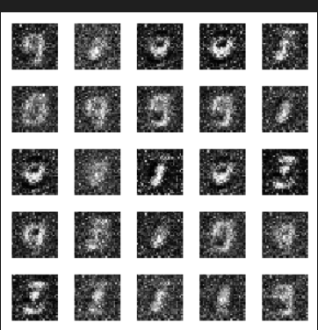
Comparison after 400 iterations
Our Algorithm FID:219.22 IS: 3.96
GDA: FID:248.06 IS: 3.23

Slide 18
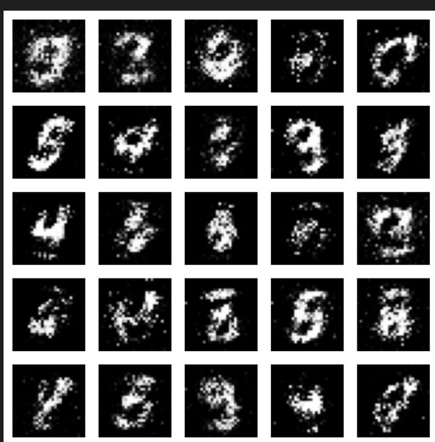
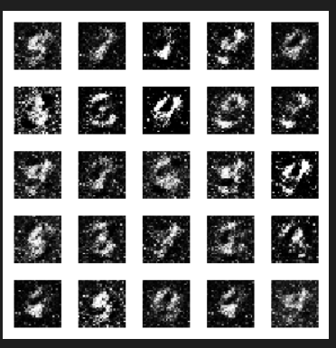
Comparison after 800 iterations
Our Algorithm: FID: 97.75 IS: 4.49
GDA: FID: 198.93 IS:3.80

Slide 19
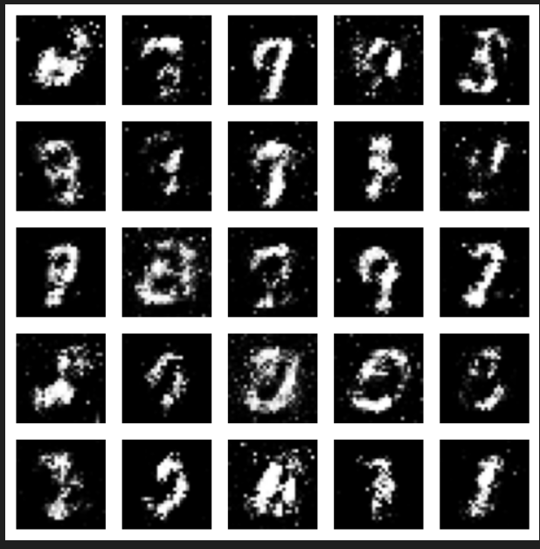
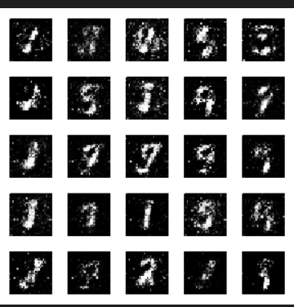
Comparison after 1200 iterations
Our algorithm FID:77.74 IS:5.04
GDA: FID: 137.10 IS:3.67

Slide 20
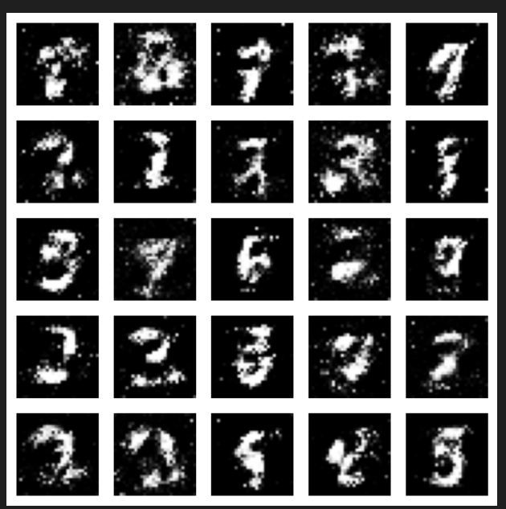
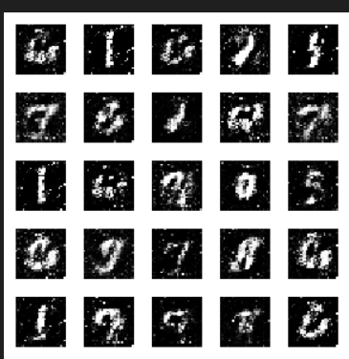
Comparison After 1600 iterations
Our algorithm: FID:72.13 IS:5.52
GDA: FID: 119.62 IS: 4.77

Slide 21
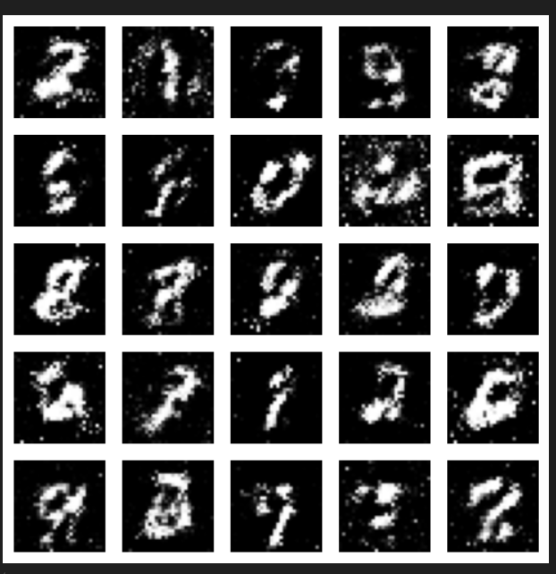
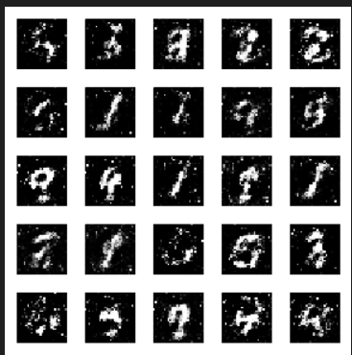
Comparison after 2000 iterations
Our algorithm: FID: 63.27 IS: 5.17
GDA:FID Score: 111.76 Inception Score: 5.16

Slide 22
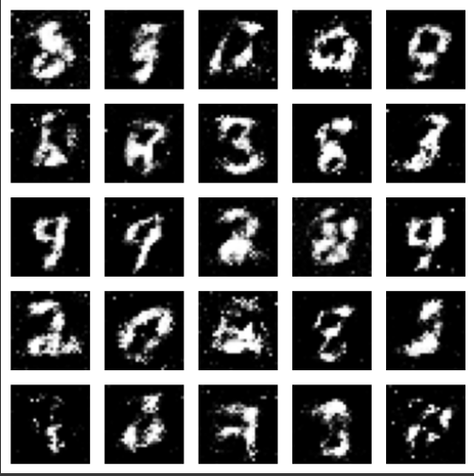
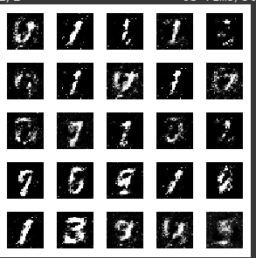
Comparison after 2400 iterations

Slide 23
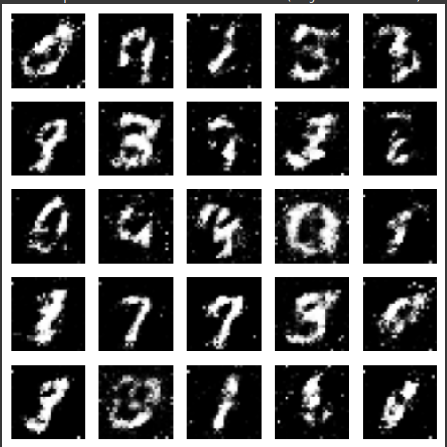
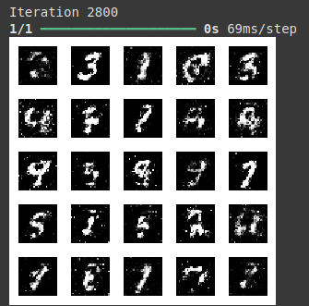
Comparison after 2800 iterations

Slide 24
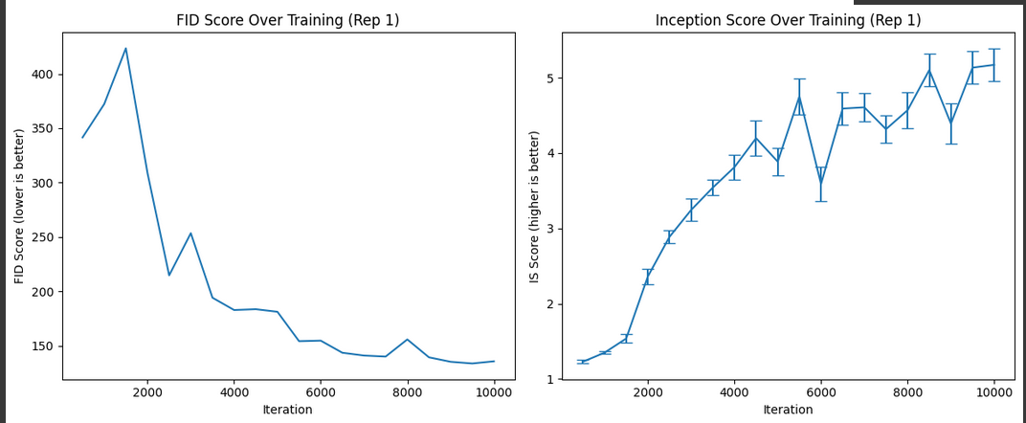
Graph of the Algorithm

Slide 25
Summary
Iteration | Algorithm (FID / IS) | GDA (FID / IS) | Observation
400 | 219.22 / 3.96 | 248.06 / 3.23 | Algorithm better in FID and IS (both poor overall).
800 | 97.59 / 4.49 | 198.92 / 3.80 | Algorithm outperforms GDA in both FID and IS.
1200 | 77.74 / 5.04 | 137.10 / 3.66 | Algorithm significantly better in both FID and IS .
1600 | 72.13 / 5.52 | 119.62 / 4.76 | Algorithm still leads in both FID and IS , gap remains large.
2000 | 63.27 / 5.17 | 111.76 / 5.15 | Algorithm maintains lead in both FID and IS, though gap in IS narrows slightly.
2400 | 56.79/5.31 | 105.95/4.89 | Algorithm continues to outperform GDA in both FID and IS.
2800 | 59.62/5.60 | 89.84/5.11 | Algorithm still leads in FID and IS, gap in FID slightly increases.

Slide 26
Thank You
Team members :
Ansh Acharya - 2023101069
Atharva Kulkarni - 2023101072
Monosij Roy - 2023111016

